Slide 1



Chair Share
Automated group library seat booking system
Team Name: Newbie

Slide 2


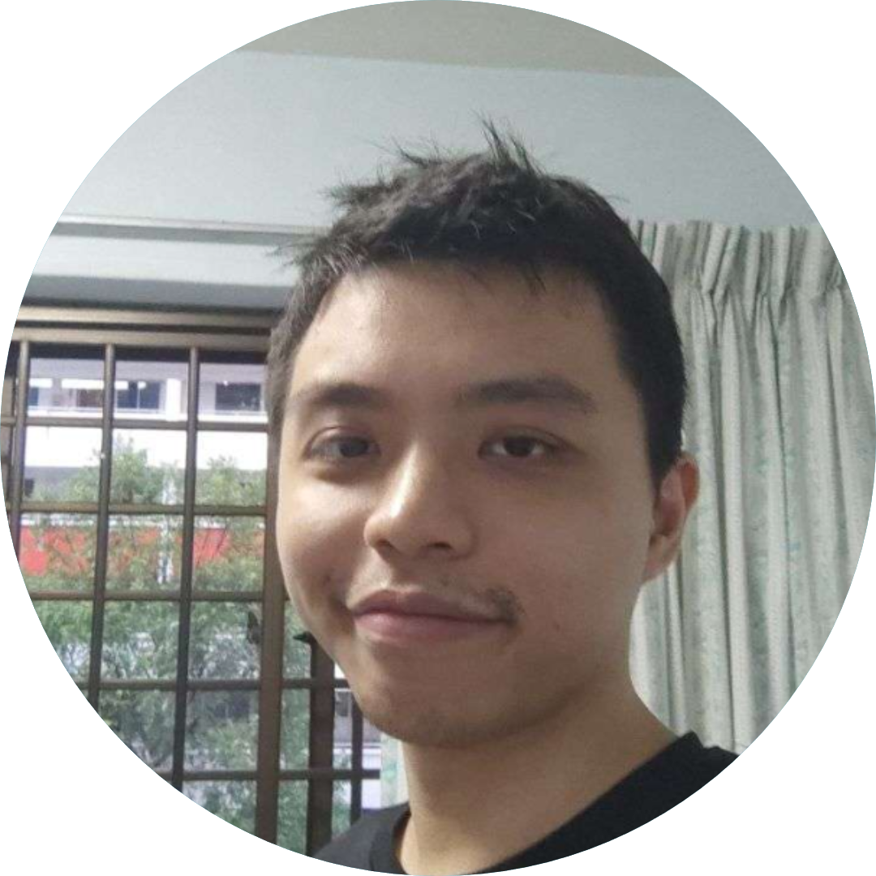
Team Slide
Hendy
Kwek Ee Chern
Lim Wei Yang
NTU CS Year 2
H002@e.ntu.edu.sg
NTU CS Year 2 KWEK0076@e.ntu.edu.sg
NTU EEE Year 3 WLIM125@e.ntu.edu.sg
Notes:
Please replace photograph with your team member by right click on image > change picture
Please add role and company name and add your email ID.
Feel free to remove extra picture and details if team size is smaller

Slide 3
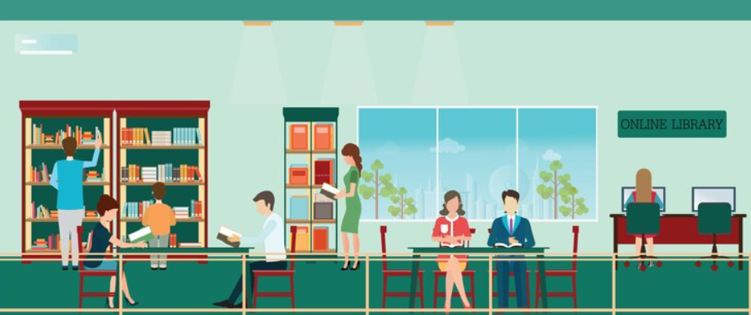
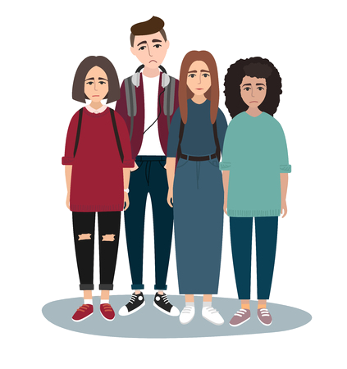
Problem Statement & Motivation
Inadequate tools for group seats booking in NLB libraries
Notes:
Problem: Please briefly mention what is the problem you are trying to solve / what is problem statement
In Singapore, group library bookings are often a challenging and time-consuming task. With the increasing demand for study spaces and group meetings, libraries are experiencing an overwhelming amount of requests for booking seats, making it difficult for users to secure a space.
This is especially problematic during peak periods, such as exam periods, where students and other library users require a conducive environment to study and work collaboratively. The current manual booking process results in long waiting times, frustration, and dissatisfaction.
This issue hinders the efficient and effective utilization of library resources and affects the quality of learning and productivity of library users.
Therefore, there is a need for an automated group library seat booking system that can streamline the booking process, improve access, and enhance the user experience.
Currently, finding seat in library as a group proves to be difficult as they need to look for unoccupied seats with the same table that match the group size and the larger the group size the harder it is to find the suitable place. The group need to look through all the areas in the library.
[PS]
In Singapore, group library bookings are often a challenging and time-consuming task. With the increasing demand for study spaces and group meetings, libraries are experiencing an overwhelming amount of requests for booking seats, making it difficult for users to secure a space.

Slide 4
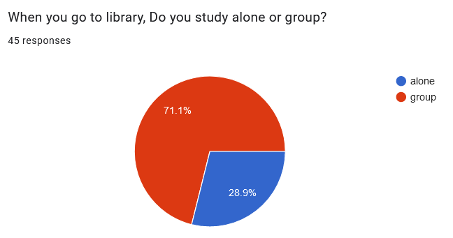
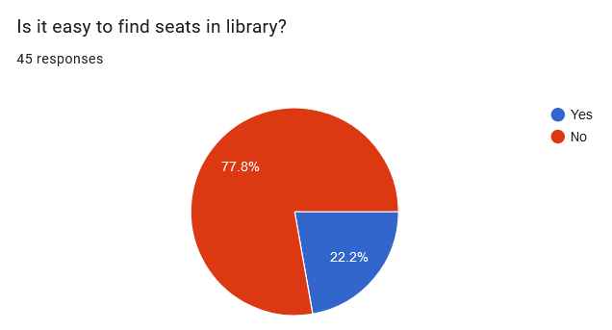
Problem Statement & Motivation
Survey done by 45 students suggested that it is difficult for study group to find seats in NLB library.

Slide 5

Proposed Solution
Automated Group Booking System
- User Inputs
- Background search into the library list
- Check on available seats
- Choose and select suitable seats
Notes:
Solution: What approach you took to solve the problem/ what is the solution / your solution to the problem
References : https://media.istockphoto.com/id/1300369190/vector/group-of-students-sitting-at-table-and-studying.jpg?s=612x612&w=0&k=20&c=isx0IC3xnYWSDoFTGvxq3Acewcd5NjFU1LHjBApkuIA=

Slide 6
Technologies Used
End-users
User Department
Industries
UIPath Products Used
Other Technologies Used
Students
Professional (Coworking space)
Customer service
Education
Customer service
Education
Library
Orchestrator
Studio
Telegram Messenger
Notes:
Solution: What approach you took to solve the problem/ what is the solution / your solution to the problem
References : https://media.istockphoto.com/id/1300369190/vector/group-of-students-sitting-at-table-and-studying.jpg?s=612x612&w=0&k=20&c=isx0IC3xnYWSDoFTGvxq3Acewcd5NjFU1LHjBApkuIA=

Slide 7
Benefits
Time Saving
Time consuming factor:
Travel (15 Mins) (Cannot be automated)
Searching for suitable seats in library (10-30 mins) (Automated)
Book the seat (3 Mins) (Automated)
Time save per visits : 13-33 Mins
(NLB reported about 24,000 physical visits per day)[1].
Total Time save : 24,000 visits * 13-33 Mins * 20%
1040 hours - 2640 hours*
Other Benefits
Potential Increment of NLB Library visitor
Efficient Group Ordering
Reduce Human Error
Notes:
Solution: What approach you took to solve the problem/ what is the solution / your solution to the problem
References : https://media.istockphoto.com/id/1300369190/vector/group-of-students-sitting-at-table-and-studying.jpg?s=612x612&w=0&k=20&c=isx0IC3xnYWSDoFTGvxq3Acewcd5NjFU1LHjBApkuIA=

Slide 8
Benefits & Technologies Used
Time Saving
Time consuming factor:
Travel (15 Mins) (Not automated)
Searching for suitable seats in library (10-30 mins) (Automated)
Book the seat (3 Mins) (Automated)
Time save per visits : 13-33 Mins
(NLB reported about 24,000 physical visits per day)[1].
Total Time save : 24,000 visits * 13-33 Mins * 20%
1040 hours - 2640 hours*
Potential Increment of NLB Library visitor
Efficient Group Ordering
Reduce Human Error
Notes:
Details: It’s always good to share details like who is the end-user of your solution, which department/industry will benefit and what technologies have been used.
Benefits: Please include key features / value proposition of your solution
As of 2021, the National Library Board (NLB) reported that there were more than 3 million registered users of public libraries in Singapore. This includes residents of Singapore as well as non-residents who are eligible for library membership. In addition, NLB reported that there were over 19 million physical visits to public libraries in Singapore and over 5 million virtual visits to its digital library resources in 2020.
The National Library Board (NLB) of Singapore reported that before the COVID-19 pandemic, their libraries received an average of about 720,000 physical visits per month, which works out to approximately 24,000 visits per day. However, due to safe management measures and temporary closures during the pandemic, the number of physical visits to the libraries has been significantly reduced. NLB has implemented measures such as capacity limits, mandatory mask-wearing, and increased cleaning and sanitization to ensure the safety of library users and staff.
The National Library Board (NLB) of Singapore has reported a significant decrease in physical visits to libraries due to the COVID-19 pandemic and the accompanying safe management measures. As of September 2021, NLB reported an average of about 24,000 physical visits per day to their libraries, which is lower than pre-COVID levels. However, NLB has also reported a significant increase in the use of their digital resources and services, with more than 5 million virtual visits to their digital library resources in 2020. The NLB has implemented various measures to ensure the safety of library users and staff, including capacity limits, mandatory mask-wearing, and increased cleaning and sanitization.
Reference:
[1] https://www.enterprisesg.gov.sg/-/media/esg/files/quality-and-standards/business-excellence/SQASC_NLB_2018_summary_report.pdf

Slide 9
Benefits & Technologies Used
Details
Benefits
End-User | Students Professional (Coworking space)
User Department | Customer service Education
Industries | Customer service Education Library
UiPath Products Used | Orchestrator Studio
Other – Integrations / APIs / Technologies Used | Telegram Messenger
Time Saving
Time consuming factor:
Travel (15 Mins) (Not automated)
Searching for suitable seats in library (10-30 mins) (Automated)
Book the seat (3 Mins) (Automated)
Time save per visits : 13-33 Mins
(NLB reported about 24,000 physical visits per day)[1].
Total Time save : 24000 visits * 13-33 Mins * 20%
1040 hours - 2640 hours*
Potential Increment of NLB Library visitor
Efficient Group Ordering
Reduce Human Error
Notes:
Details: It’s always good to share details like who is the end-user of your solution, which department/industry will benefit and what technologies have been used.
Benefits: Please include key features / value proposition of your solution
As of 2021, the National Library Board (NLB) reported that there were more than 3 million registered users of public libraries in Singapore. This includes residents of Singapore as well as non-residents who are eligible for library membership. In addition, NLB reported that there were over 19 million physical visits to public libraries in Singapore and over 5 million virtual visits to its digital library resources in 2020.
The National Library Board (NLB) of Singapore reported that before the COVID-19 pandemic, their libraries received an average of about 720,000 physical visits per month, which works out to approximately 24,000 visits per day. However, due to safe management measures and temporary closures during the pandemic, the number of physical visits to the libraries has been significantly reduced. NLB has implemented measures such as capacity limits, mandatory mask-wearing, and increased cleaning and sanitization to ensure the safety of library users and staff.
The National Library Board (NLB) of Singapore has reported a significant decrease in physical visits to libraries due to the COVID-19 pandemic and the accompanying safe management measures. As of September 2021, NLB reported an average of about 24,000 physical visits per day to their libraries, which is lower than pre-COVID levels. However, NLB has also reported a significant increase in the use of their digital resources and services, with more than 5 million virtual visits to their digital library resources in 2020. The NLB has implemented various measures to ensure the safety of library users and staff, including capacity limits, mandatory mask-wearing, and increased cleaning and sanitization.
Reference:
[1] https://www.enterprisesg.gov.sg/-/media/esg/files/quality-and-standards/business-excellence/SQASC_NLB_2018_summary_report.pdf

Slide 10
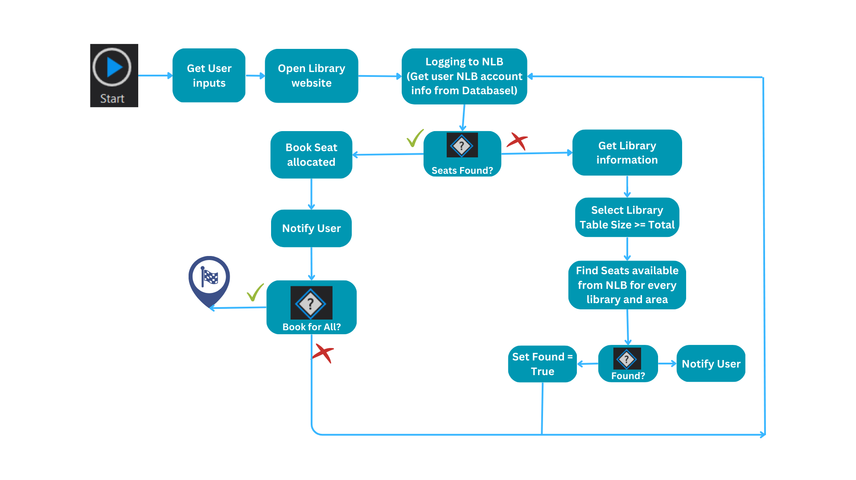
Solution Flowchart
Notes:
Flowchart of the solution.
Find Seat available for every library and area will be explained further on the next slide.

Slide 11
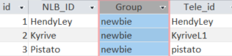
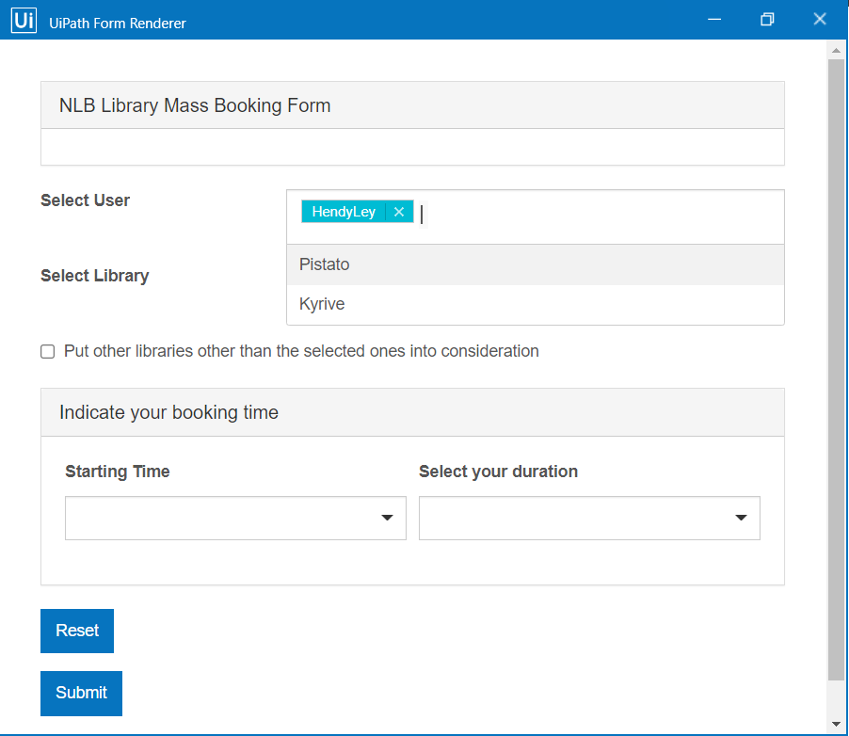
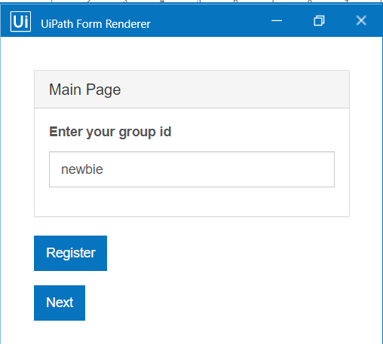
Find Seat available for every library and area
Data structure
Notes:
The following image shows one of the area layout of Ang mo kio library, In the excel we specify the same tableid for seats on the same table.

Slide 12
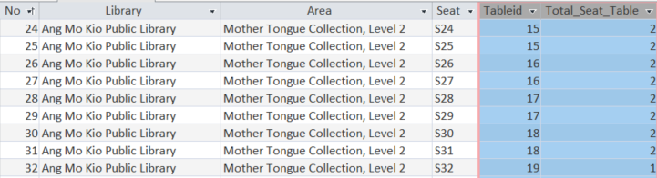
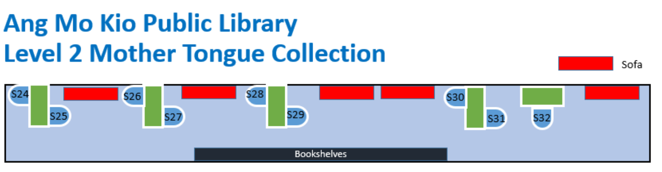
Find Seat available for every library and area
Data structure
Notes:
The following image shows one of the area layout of Ang mo kio library, In the excel we specify the same tableid for seats on the same table.

Slide 13
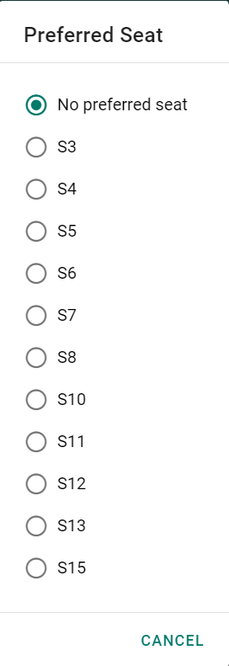
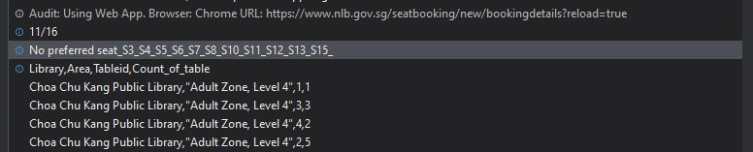
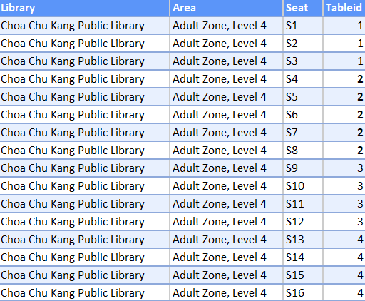
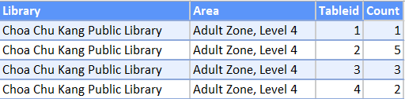
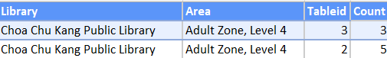
Find Seat available for every library and area
1
2
3
4
5
Notes:
From the appointment booking site, the seat selection contain information of seats that is available for the user to book.
We can extract the information as a text and check every row that we have
If text contain the seat id, we will include it into the table you see in point 3
We then add an additional column call “Count” to calculate the total number of available seat for each tableid
We then filter out count that is smaller than our team size, for example our group size is 3, 2 will be filtered out. We will then sort the table from smallest to biggest based on count, to find the most optimized option for us. For this case table 1 will be selected but if we have 4 team size table 2 or 3 will be considered, if team size 5, we will search other area options

Slide 14
Find Seat available for every library and area
1
Notes:
From the appointment booking site, the seat selection contain information of seats that is available for the user to book.
We can extract the information as a text and check every row that we have
If text contain the seat id, we will include it into the table you see in point 3
We then add an additional column call “Count” to calculate the total number of available seat for each tableid
We then filter out count that is smaller than our team size, for example our group size is 3, 2 will be filtered out. We will then sort the table from smallest to biggest based on count, to find the most optimized option for us. For this case table 1 will be selected but if we have 4 team size table 2 or 3 will be considered, if team size 5, we will search other area options

Slide 15
Find Seat available for every library and area
2
Notes:
From the appointment booking site, the seat selection contain information of seats that is available for the user to book.
We can extract the information as a text and check every row that we have
If text contain the seat id, we will include it into the table you see in point 3
We then add an additional column call “Count” to calculate the total number of available seat for each tableid
We then filter out count that is smaller than our team size, for example our group size is 3, 2 will be filtered out. We will then sort the table from smallest to biggest based on count, to find the most optimized option for us. For this case table 1 will be selected but if we have 4 team size table 2 or 3 will be considered, if team size 5, we will search other area options

Slide 16
Find Seat available for every library and area
3
Notes:
From the appointment booking site, the seat selection contain information of seats that is available for the user to book.
We can extract the information as a text and check every row that we have
If text contain the seat id, we will include it into the table you see in point 3
We then add an additional column call “Count” to calculate the total number of available seat for each tableid
We then filter out count that is smaller than our team size, for example our group size is 3, 2 will be filtered out. We will then sort the table from smallest to biggest based on count, to find the most optimized option for us. For this case table 1 will be selected but if we have 4 team size table 2 or 3 will be considered, if team size 5, we will search other area options

Slide 17
Find Seat available for every library and area
3
Notes:
From the appointment booking site, the seat selection contain information of seats that is available for the user to book.
We can extract the information as a text and check every row that we have
If text contain the seat id, we will include it into the table you see in point 3
We then add an additional column call “Count” to calculate the total number of available seat for each tableid
We then filter out count that is smaller than our team size, for example our group size is 3, 2 will be filtered out. We will then sort the table from smallest to biggest based on count, to find the most optimized option for us. For this case table 1 will be selected but if we have 4 team size table 2 or 3 will be considered, if team size 5, we will search other area options

Slide 18
Find Seat available for every library and area
4
Notes:
From the appointment booking site, the seat selection contain information of seats that is available for the user to book.
We can extract the information as a text and check every row that we have
If text contain the seat id, we will include it into the table you see in point 3
We then add an additional column call “Count” to calculate the total number of available seat for each tableid
We then filter out count that is smaller than our team size, for example our group size is 3, 2 will be filtered out. We will then sort the table from smallest to biggest based on count, to find the most optimized option for us. For this case table 1 will be selected but if we have 4 team size table 2 or 3 will be considered, if team size 5, we will search other area options

Slide 19
Find Seat available for every library and area
4
Notes:
From the appointment booking site, the seat selection contain information of seats that is available for the user to book.
We can extract the information as a text and check every row that we have
If text contain the seat id, we will include it into the table you see in point 3
We then add an additional column call “Count” to calculate the total number of available seat for each tableid
We then filter out count that is smaller than our team size, for example our group size is 3, 2 will be filtered out. We will then sort the table from smallest to biggest based on count, to find the most optimized option for us. For this case table 1 will be selected but if we have 4 team size table 2 or 3 will be considered, if team size 5, we will search other area options

Slide 20

Find Seat available for every library and area
5
Notes:
From the appointment booking site, the seat selection contain information of seats that is available for the user to book.
We can extract the information as a text and check every row that we have
If text contain the seat id, we will include it into the table you see in point 3
We then add an additional column call “Count” to calculate the total number of available seat for each tableid
We then filter out count that is smaller than our team size, for example our group size is 3, 2 will be filtered out. We will then sort the table from smallest to biggest based on count, to find the most optimized option for us. For this case table 1 will be selected but if we have 4 team size table 2 or 3 will be considered, if team size 5, we will search other area options

Slide 21
Find Seat available for every library and area
5
Notes:
From the appointment booking site, the seat selection contain information of seats that is available for the user to book.
We can extract the information as a text and check every row that we have
If text contain the seat id, we will include it into the table you see in point 3
We then add an additional column call “Count” to calculate the total number of available seat for each tableid
We then filter out count that is smaller than our team size, for example our group size is 3, 2 will be filtered out. We will then sort the table from smallest to biggest based on count, to find the most optimized option for us. For this case table 1 will be selected but if we have 4 team size table 2 or 3 will be considered, if team size 5, we will search other area options

Slide 22

Solution Demo
Notes:
! account ~30 seconds

Slide 23
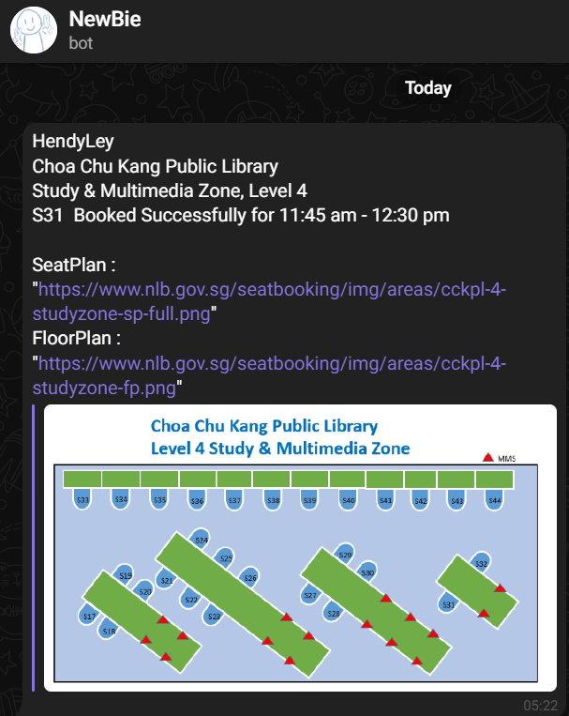
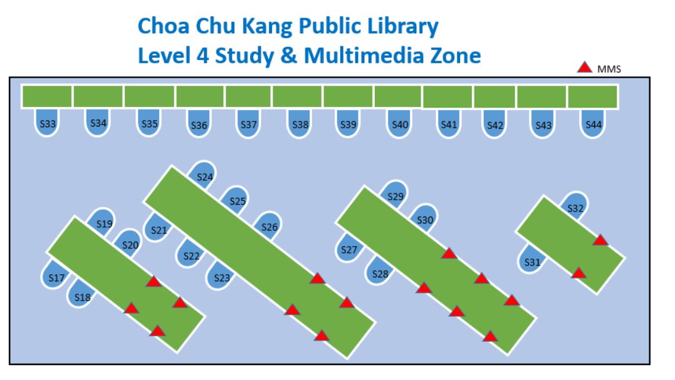
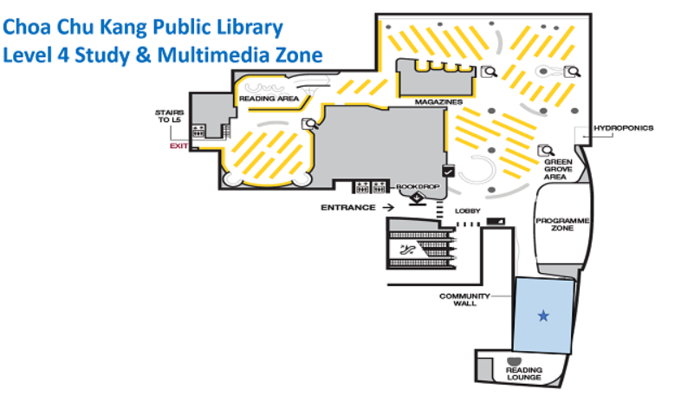
Telegram bot

Slide 24



Future Enhancements
Create a UIPath app for users / Booking seats using Telegram.
Work with companies for identity provider.
Expanding to book co- working spaces for companies especially for those without an office.

Slide 25


Slide 26

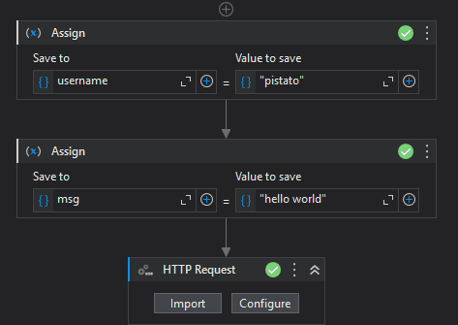


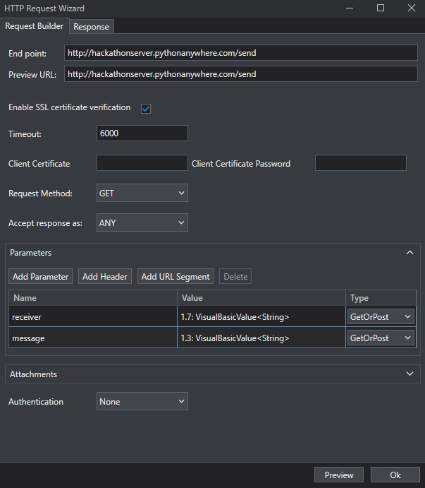

Notes:
For our output, we used a telegram bot through the pyTelegramBotAPI library to inform our users of successful bookings.
The python script is being run from pythonanywhere.com and is being run as a webapp through the use of Flask. By implementing it as a webapp, the end user does not have to install python and its dependencies, and the bot’s API key can be protected on the server. Furthermore, it is essential as a dictionary of username:user-id data has to be maintained by the python script.
The python script takes in a receiver’s username and message value into the url and sends it through the send message function by referencing the dictionary of username:user-id.
Lastly, the robot enters the webapp like in the sample url below:
http://hackathonserver.pythonanywhere.com/send?receiver=pistato&message=hello+world
Going to this webpage will send a message to Pistato with the text, “Hello World”. However, due to limitations imposed by Telegram, the message can only be sent if the user has used the /start command with the Telegram bot at https://t.me/RPAHackathonNewBieBot
Thus using the get request activity on UIPath, we send a request to the webapp and in doing so, send a message to the telegram user.

